Slide 1
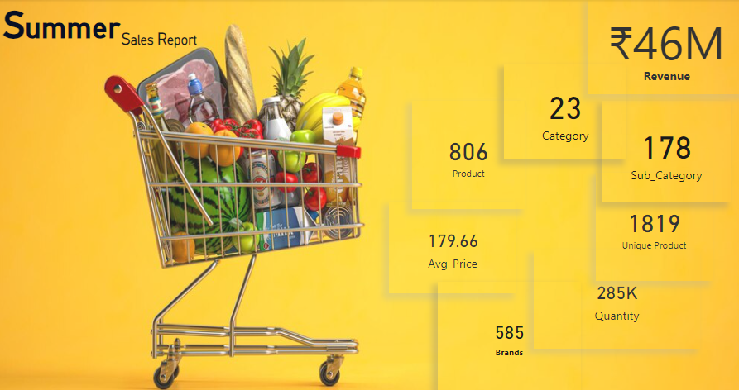

Slide 2
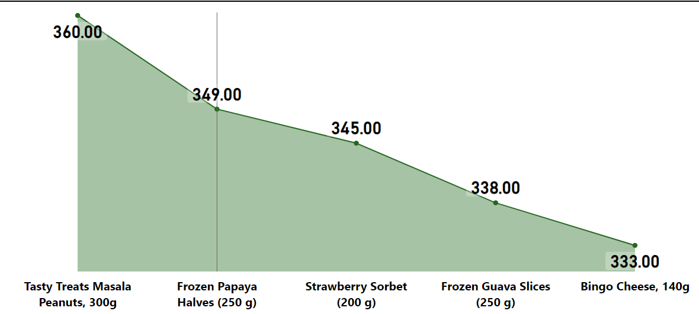
Top 5 Selling Products by Quantity
Reason
Frozen papaya, Strawberry sorbet 200g and frozen guava slices are most selling products due to summer season.
Tasty treats masala peanuts is a snack so it consumes all months.
Bingo cheese 140g is a 5th selling product because due to less inventory in a mid of May.
Solution
After summer season Frozen papaya, Strawberry sorbet 200g and frozen guava slices sells will decrease so we have to increase winter products.
Tasty treats, Bingo cheese 140g is a daily consume product and it consumes in all months so we have to increase this product inventory as per the supply and demand.

Slide 3
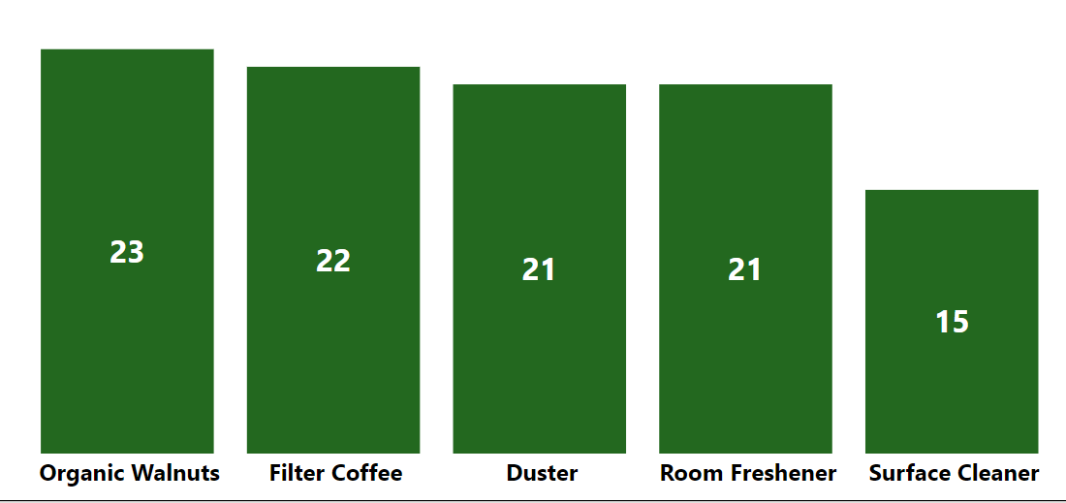
Bottom 5 Selling Products by Quantity
Reason:
Room freshner product sold less because in the month of MAY stock had finished.
Surface cleaner product offers were not available in March and April that’s why we can see the sells are less.
Filter coffee sold less due to summer season because in summer season ice cream and other beverages items are sold more.
Solutions:
In the next month more Room freshner products have to be stored in inventory and also need to add some great offers which attract to the customer.
We have to apply offers and promotional discount on room freshner products.
In winter season filter coffee will sell more to we have to add more stock of filter coffee.

Slide 4
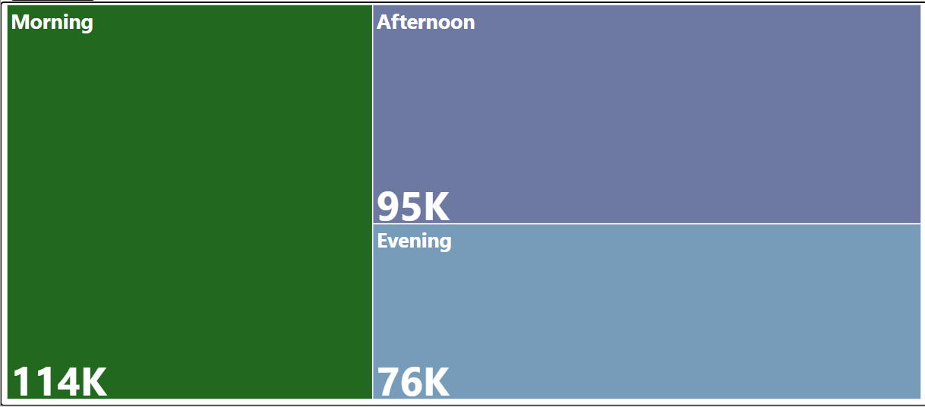
Shift Wise Quantity Sold
Reasons:
In morning shift customer consume more Quantity in the morning shift because of fresh produce availability.
People might avoid shopping in the evening due to traffic congestion or the rush to get home after work. This can deter customers from stopping by your store after work, leading to lower sales during the evening shift.
People often buy their groceries in the morning for school lunches or work meals. By evening, they may not have any urgent grocery needs, so they’re less likely to stop by.
the evening is a peak time for traffic congestion and crowded public transport. Many people would rather shop in the afternoon,

Slide 5
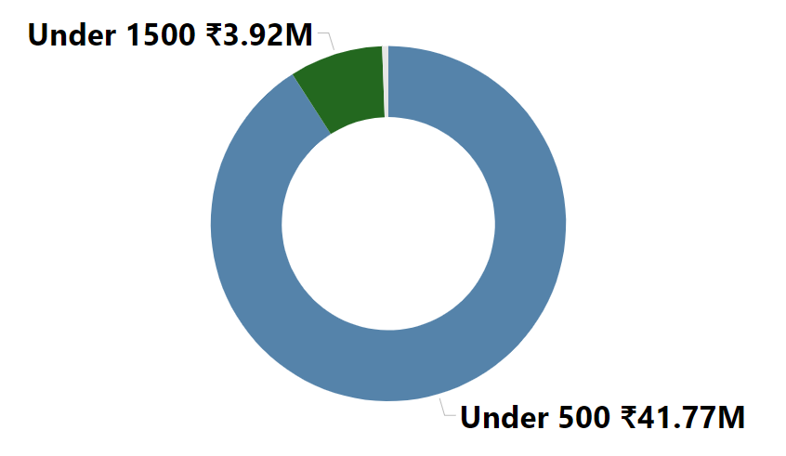
Revenue by Price Category
Reason:
Products which are above 1500 price are generating less revenue because products available above 1500 price having less quantity available in the store.
Because of the maximum cost of products most people are using under 1500 or under 500 value product.
Products which are under 500 price are generating maximum revenue because products available above 1500 price are having less quantity available in grocery store.
Solution:
We have to increase above 1500 price quantity products in mart and also under 1500 price category product quantity have to increase it. So the people can buy it and we can generate more sells.
We have to increase above 1500 price quantity products in mart also for the under 1500 price category product quantity have to increase it.

Slide 6
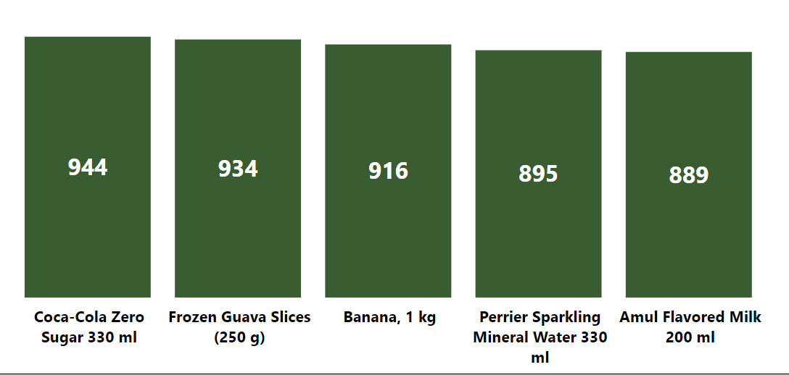
Top 5 Selling Products by Revenue
Reason:
Coca-Cola has a strong global brand presence, making it a familiar choice for many consumers.
The unique taste and the variety of options (like Diet Coke, Coke Zero, flavored versions) appeal to different preferences.
It’s widely available and often placed prominently in stores, making it easy for customers to grab.
Solutions:
After summer there Is a possibility that coco cola , Amul flavoured milk and frozen guava sales will decreased so we have to go with tea, coffee products because in Rainy and winter it consumes more.
Offer limited-time discounts or bundle deals on popular items, including Coca-Cola. This can encourage bulk purchases

Slide 7
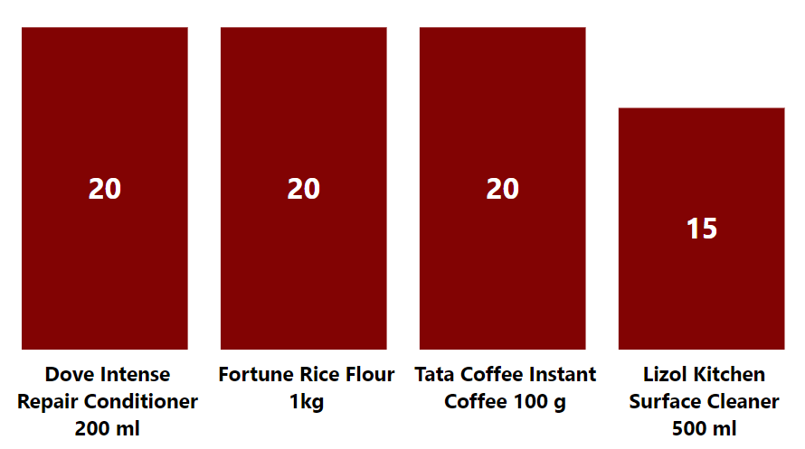
Bottom 4 Selling Products by Revenue
Reason:
In Fortune rice flour 1kg, concession offers was not available that’s why sells are less.
These products are priced higher than alternatives, budget-conscious customers might opt for cheaper options.
They are not displayed prominently or are hard to find, customers may overlook them while shopping.
Solutions:
Create bundles that include Dove intense repair condictioner 200 ml with popular breakfast items or snacks to entice customers.
In winter season coffee consumes more so we have to go with more stock availability.
We have to applied concession offers on fortune rice flour 1kg pack also.

Slide 8
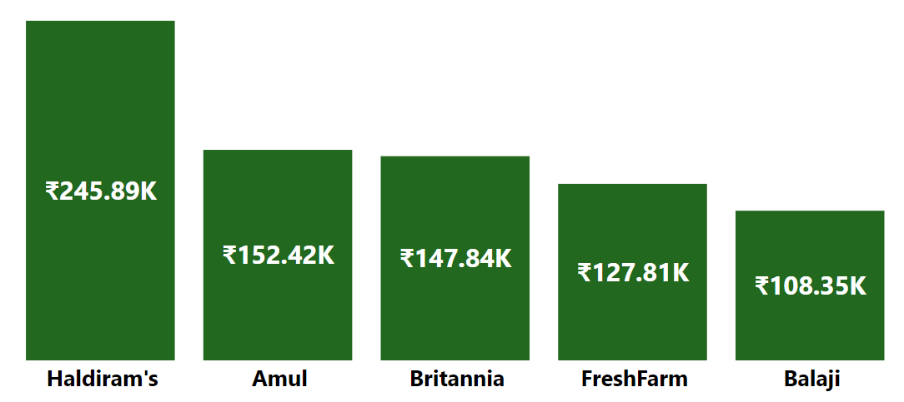
Top 5 Revenue Brands
Reasons:
Haldiram’s offers a wide variety of snacks, sweets, and ready-to-eat meals, appealing to a broad customer base.
The brand is known for its high-quality ingredients and traditional recipes, which attract customers looking for authentic Indian flavors.
Haldiram’s has built a strong reputation over the years, leading to customer loyalty and repeat purchases.
Their packaging is often appealing and convenient, making it easy for customers to choose their products.
Solution:
We need to keep those other brand products highlighted so the demand would increase and also need to add some great offers for getting some more customer interest in those brand. also we should add more products of those less generated revenue brand.

Slide 9
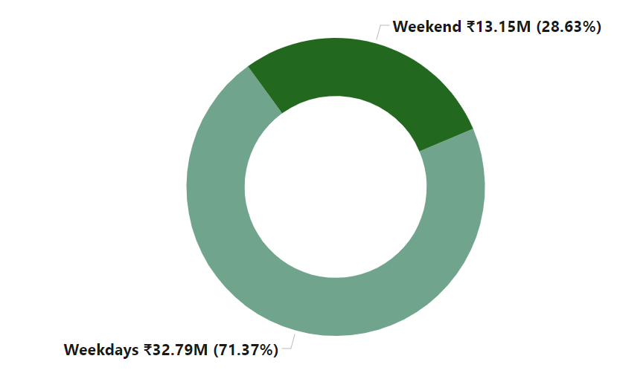
Weekly Revenue
Reasons:
Grocery stores offer weekend promotions or discounts, attracting more shoppers.
Some people may prefer shopping when stores are less crowded during weekdays, leading to a busier weekend shopping environment.
people have more free time on weekends, allowing them to shop at their convenience.
Solutions:
Offer discounts or special deals on certain days of the week to encourage shopping. For example, “Tasty Tuesday” or “Wellness Wednesday” discounts on specific items.
Stock up on quick meals, snacks, and ready-to-eat products that appeal to busy customers looking for convenience.
Use email or social media to send targeted promotions to customers, highlighting weekday deals or special events.

Slide 10
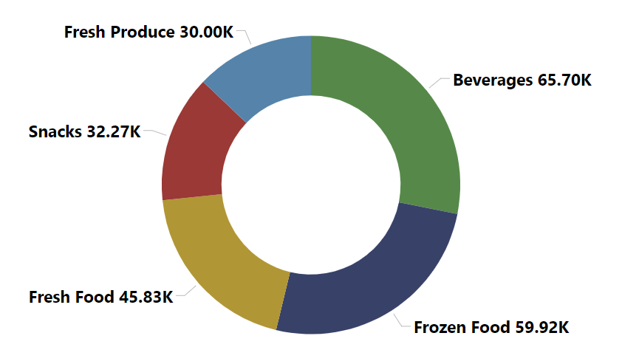
Top 5 Quantity by Price Category
Reason:
Snacks category is limited or doesn’t include popular or trending options, customers may not find what they’re looking for.
Shifts in consumer preferences toward healthier options may affect traditional snack sales.
Solutions:
Promote snacks through social media and consider offering delivery or online ordering to reach more customers.
Encourage complementary purchases by placing snacks next to related products, like drinks or party supplies.

Slide 11
THANK YOU

